Slide 1

visualization group feedback
Visualization of Democracy
Around the World
Group 5
Casper Kamp / Dongha Shin / Ejvind Brandt

Slide 2

Introduction
01
Topic / Data
02
Progress
Demo
Conclusion
03
Plan

Slide 3
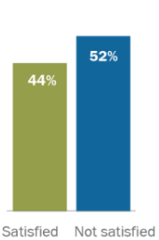


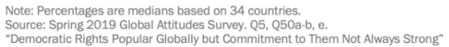
01
Introduction
Topic
“ Visualization of Democracy Around the World ”
Satifaction with
Democracy (2019)
Democracy is not working
well all over the world
<
Russia-Ukraine war
(2014. 02. 20. ~ )
Israel–Hamas war
(2023. 10. 07. ~ )

Slide 4
01
Introduction
Data
The V-dem Dataset
(explanation for the V-dem Dataset)

Slide 5
02
Progress
Demo
(Visualization screen with links)

Slide 6


03
Conclusion
Plan
What to add
1. Analysis of the correlation between the democracy score and other factors
2. radial graph
What to modify

Slide 7
Q&A

